Slide 1

DESIGN OF AIRFOIL PROFILE FOR KAPLAN TURBINE BLADES USING PYTHON PROGRAMMING
HMFPA Home Assignment
Guide :
Prof. Dr. Sachin Komble
Batch 2 Group 2
Aarya Velankar
Tanishq Chavan
Rugwed Ushir
Krishna Vyas
Sarvesh Suryavanshi

Slide 2
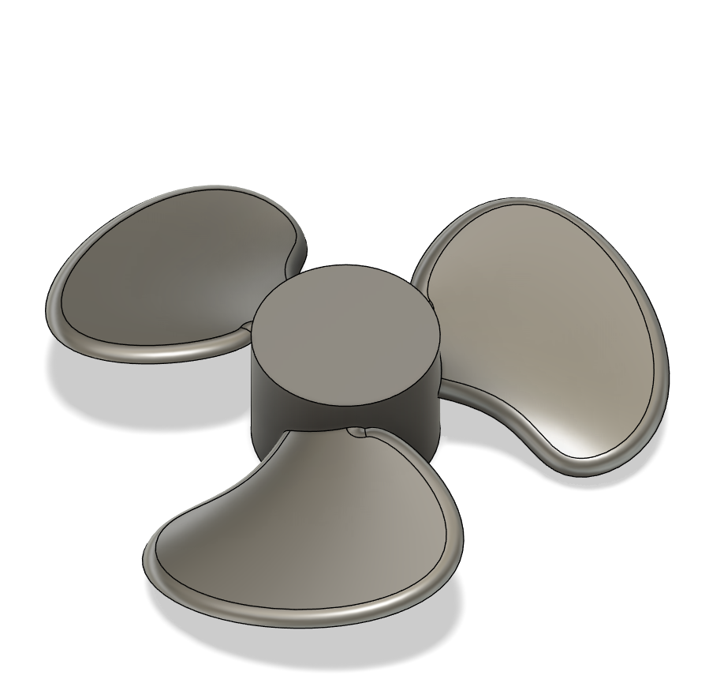
Agenda
Introduction
Literature Review
Objective
Code
Results

Slide 3
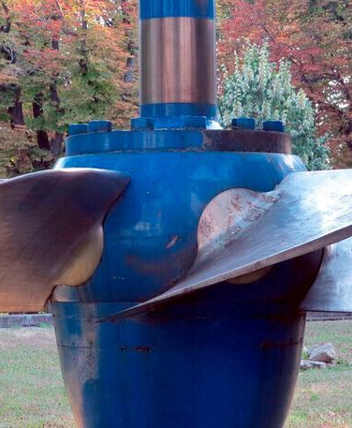
Introduction
Why is Kaplan Turbine Blade Profile Important ?
The Kaplan turbine blade profile is critical because its aerofoil shape generates the lift force necessary for rotation, directly determining the turbine's power output and operational life. Unlike fixed-blade turbines, the Kaplan's profile is often adjustable and highly twisted, allowing it to handle massive water flows at low pressure (low head) with efficiencies often exceeding 90%.

Slide 4
Literature Review
Generating the Coordinates and Graph of NACA 00xx AIRFOIL using PYTHON
Research Objectives | Key Findings
Extract Airfoil Coordinates: Use Python to solve the mathematical equations for a 4-digit NACA 0012 airfoil to obtain its precise coordinates. | Efficiency and Time Savings: The Python program significantly saves time in calculating, simplifying, and extracting coordinates when compared to manual processes.
Simplify Calculations: Automate and simplify the complex calculations involved in airfoil design compared to manual methods. | Accuracy: The results obtained through the program are accurate and reliable for engineering applications.
​Data Export and Visualization: Generate a systematic graphical representation (graph) of the airfoil and export the resulting coordinates into a CSV file format. | Utility of Libraries: The research highlights the effectiveness of specific Python libraries—NumPy for simplifying equations, Matplotlib for plotting the graphs, and Pandas for exporting data to CSV documents.

Slide 5
Objectives
Use Python to write a code for airfoil design of NACA airfoils
Take user inputs related to the Kaplan Turbine to generate a 5 plots for airfoil design of propeller blades of Kaplan turbine
The inputs include ;
NACA Airfoil number
Power
Overall Efficiency
Angle of Attack
No. of Blades
Available Head
Use the generated plots to extrude a proper blade in CAD which will be used for the Kaplan turbine

Slide 6
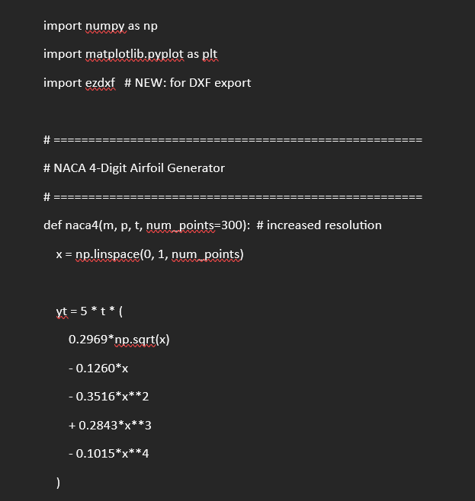
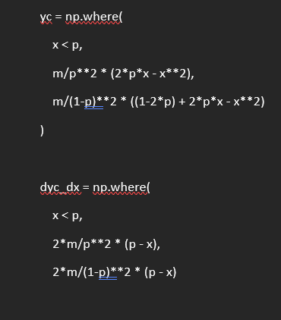
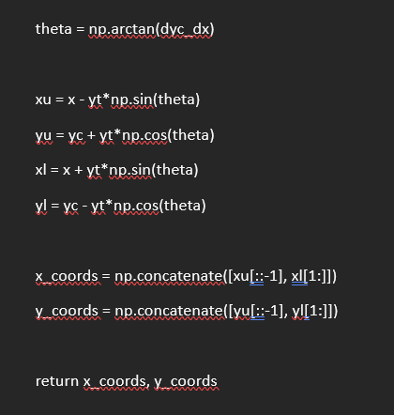
Code
Code for NACA airfoil making in Python
Important parts
Standard formulas for identifying NACA airfoil convention and calculating chord length , thickness , camber and chamfer

Slide 7
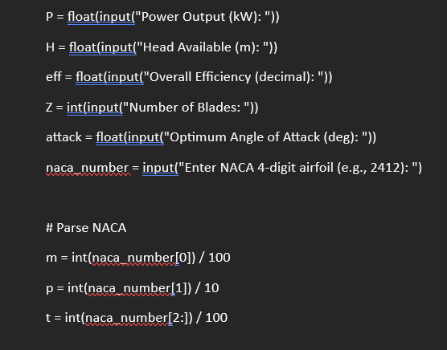
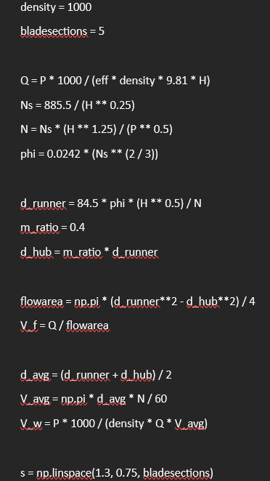
Code
Code for user inputs
Code for hydraulic calculations

Slide 8
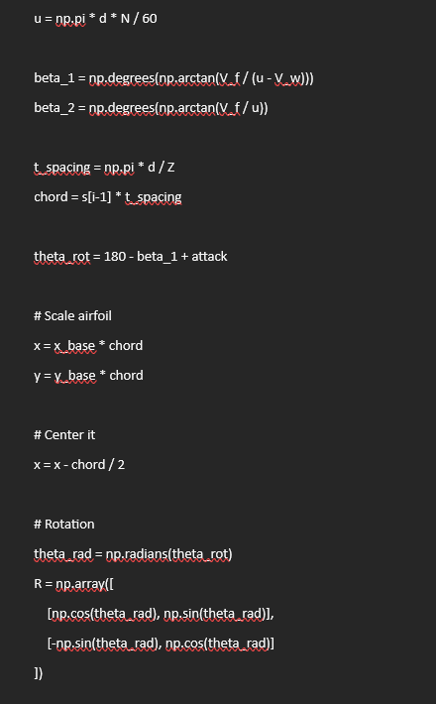
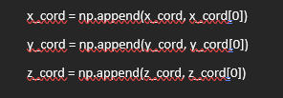
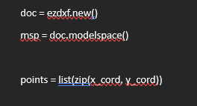
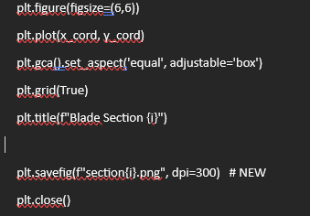
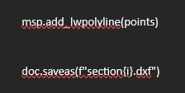
Code
Code for blade section generation
Code for generating plot and converting into DXF format
The hydraulic properties data , and blade section generation data is converted into plots of sections and converted into CAD – friendly format

Slide 9
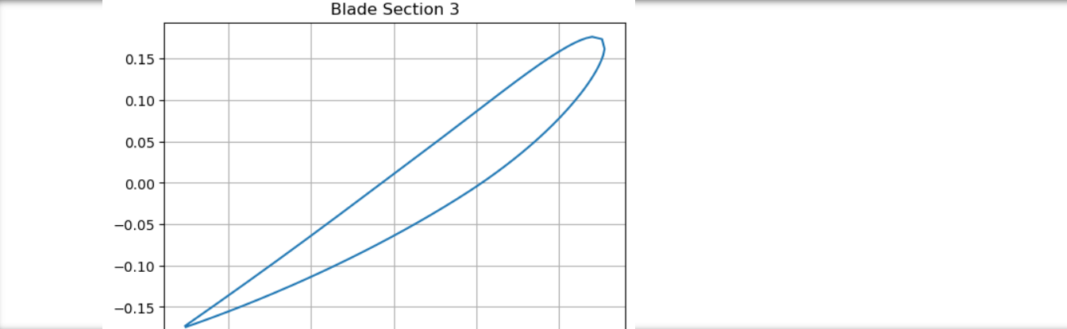
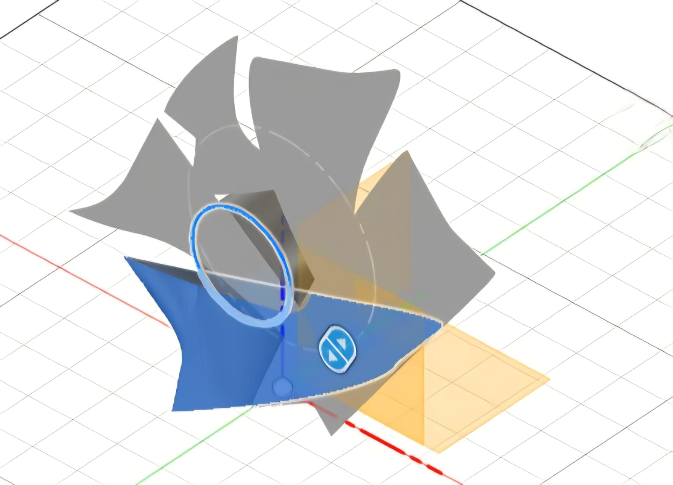
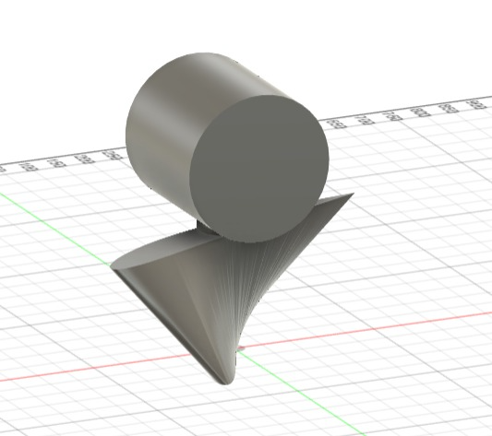
Results
Plot generated
Final Kaplan Turbine CAD using extruded blade sections
5 such plots at an interval of shift in chord angle with X-axis at 30 deg will be generated
Complex Kaplan turbine blade which is twisted across its height is generated

Slide 10
THANK YOU

